Slide 1
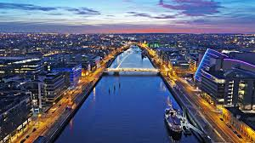
Ireland’s Business Model & Thriving Sectors:
A Global Hub for Finance and Innovation
Key Insights into Ireland’s Economic Strengths (2025)
Ralf Lissek, Director
EBTA European Business & Training Association

Slide 2
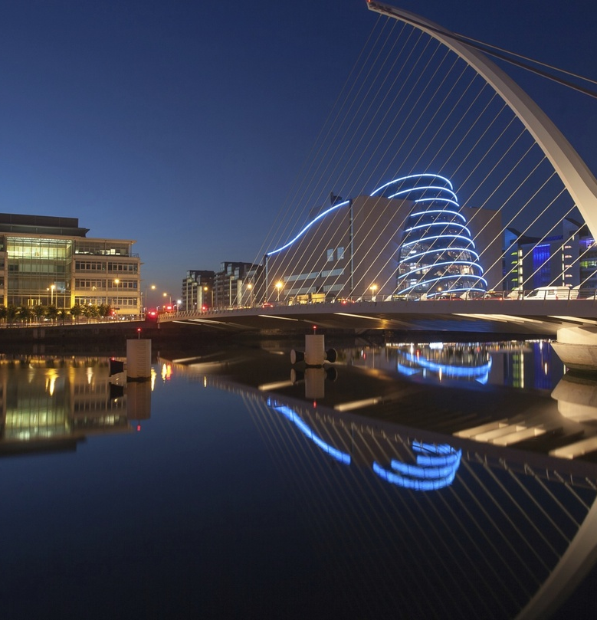

Overview of Ireland’s Business Model
Open, export-driven economy
Relies on FDI, EU single market access, and a pro-business environment
Key pillars
  Multinational dominance: 50 firms generate 53% of GVA but employ only 3% of workers
  Tax competitiveness: 12.5% corporate tax rate, double-taxation treaties with 60+ countries
  Skilled workforce: 72.9% digital competency (vs. EU average 55.6%)

Slide 3

Ireland’s Economic Performance (2025)
Growth:
  2.7% real GNI growth projected for 2025 (IMF)
  Unemployment at 4.3%, near full employment
Risks: geopolitical fragmentation, reliance on MNEs, housing shortages

Slide 4
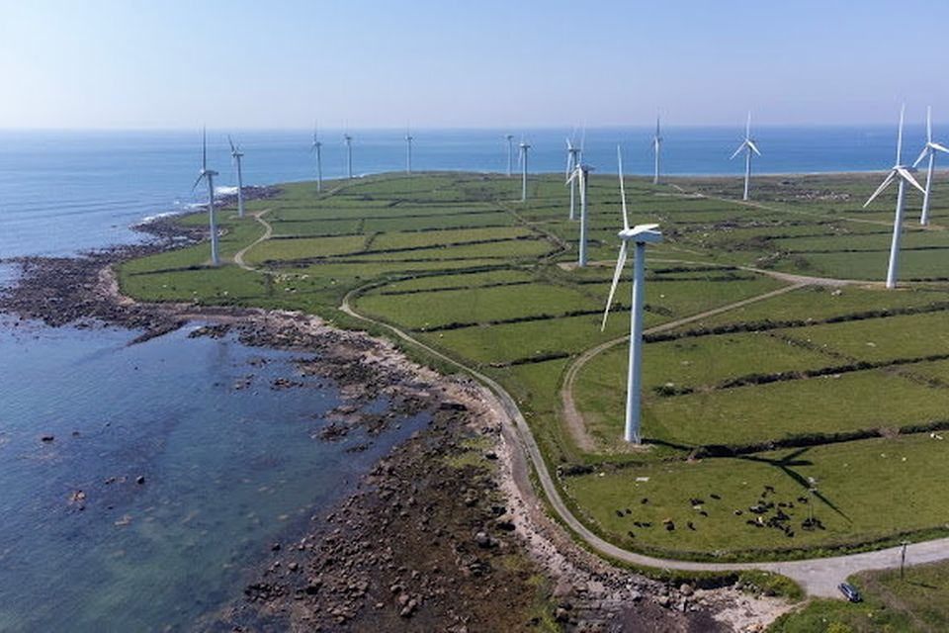
Top Thriving Sectors in Ireland
1. Financial Services (€11bn exports, 47,000 jobs) .
2. Technology (2,200 startups, AI to contribute €48bn)
3. Pharma/Life Sciences (largest net exporter in the EU).
4. Green Energy & Sustainable Finance (Climate Finance Week initiatives) .

Slide 5
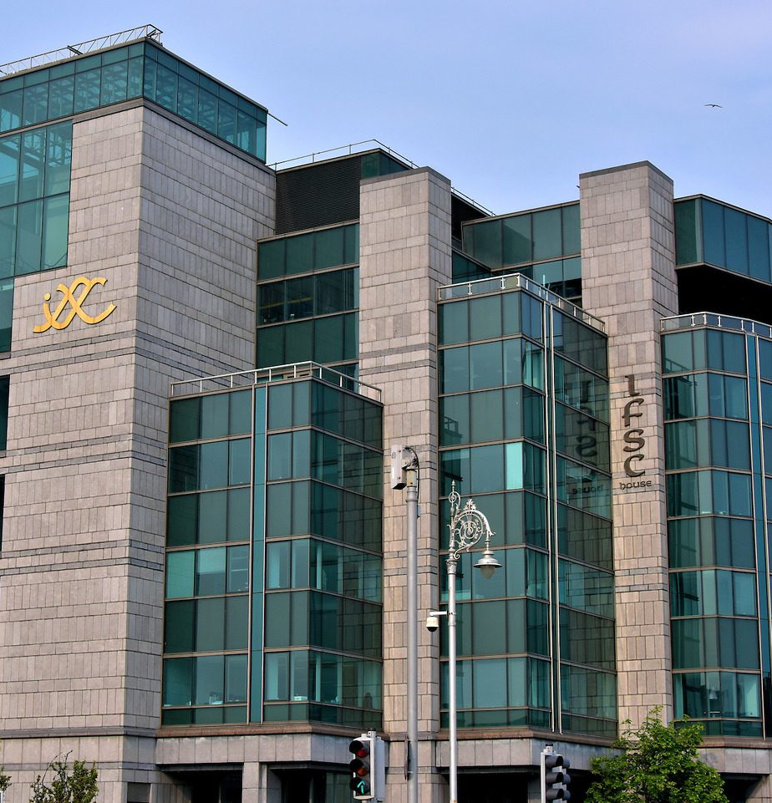
Ireland’s Financial Sector – Global Hub
Scale: 430+ firms, 17 of top 20 global banks, 11 of top 15 insurers
- Exports: €11bn annually; 6.3% of GDP .
- Strengths:
- EU passporting rights post-Brexit.
- Leading in aircraft leasing (60% global market)

Slide 6
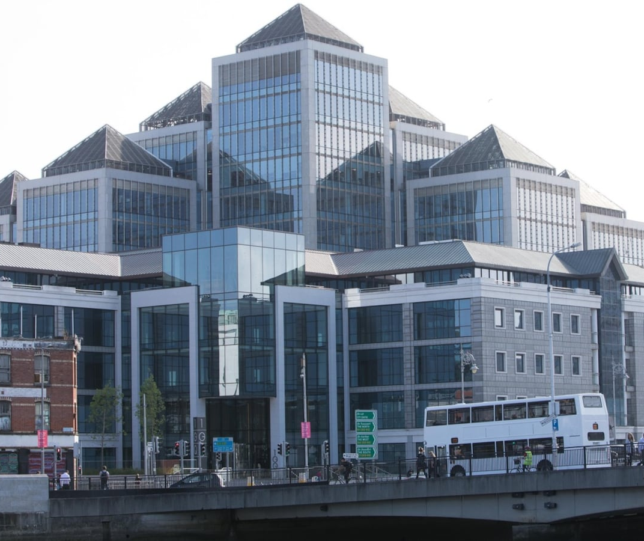
Financial Sector Growth Drivers
EY 2028 Projections:
  26% sector growth, €3.4bn additional GVA
  34% employment rise (168,000 jobs)
Key accelerators
  Fintech (e.g. Stripe, Fenergo)
  Sustainable finance (e.g., EU Green Bond listings)

Slide 7
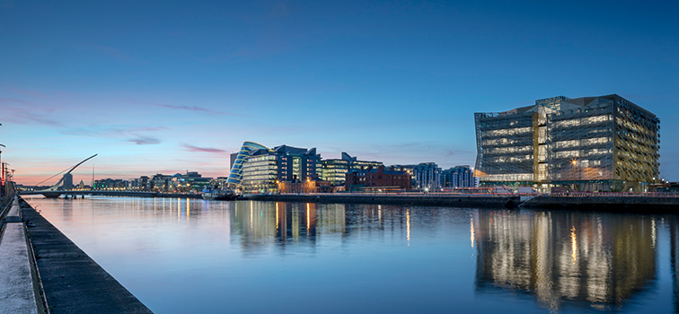
Fintech & Digital Finance
Dublin as a hub: AI, blockchain, payments innovation (e.g. Mastercard’s European Tech Hub)
Regulatory support: Central Bank’s Innovation Sandbox
Growth: 56,000 employed in financial services (2025 target)

Slide 8

Sustainable Finance Leadership
Ireland for Finance Strategy :
  Aims to be a top-tier green finance hub
  New Climate Funding Platform & Sustainable Finance Roadmap
ESG focus: Funds administering €5.2tn assets

Slide 9

Challenges for the Financial Sector
Housing/cost of living: 32% of firms cite affordability as a barrier
Global risks: US protectionism, CIT revenue volatility
Regulatory complexity: DORA, AMLD6 compliance

Slide 10
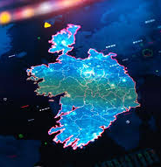
Technology Sector Boom
Key players: Google, Microsoft, Intel ($11bn semiconductor investment)
AI & Cloud: 40% of firms adopted AI; AWS contributes €11.4bn to GDP

Slide 11

Government & Policy Support
Ireland for Finance 2025: Targets 50,000 financial sector jobs .
Pillar Two tax reforms: Minimum 15% global tax for MNEs
National Development Plan: €165bn for infrastructure

Slide 12

Regionalisation & Talent
Beyond Dublin: Cork, Galway, Limerick hubs (cost efficiency + talent)
Skills focus: STEM education, upskilling (€1.5bn National Training Fund)

Slide 13
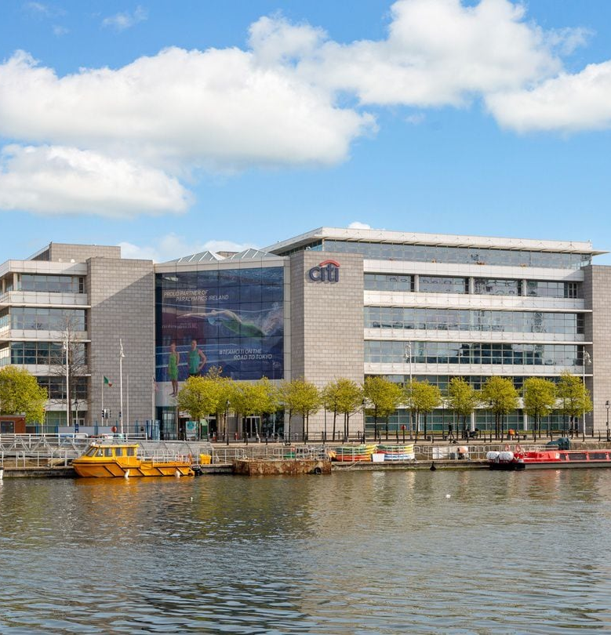
Case Study – Citi & State Street
Citi: 2,500 employees in Ireland (treasury, securities)
State Street: Fund administration for €5.2tn assets

Slide 14

Future Outlook
Financial services: AI, green finance, and crypto (e.g., Zodia Custody) .
Tech: Expansion in AI, cybersecurity, and semiconductors.
Risks: Housing, global trade fragmentation

Slide 15

Conclusion & Key Takeaways
1. Ireland’s model thrives on FDI, EU access, and sectoral specialization.
2. Finance is a cornerstone: Innovation (fintech), sustainability, and funds dominance.
3. Challenges: Address housing, diversify tax base, and monitor global risks.
4. Opportunities: AI, green transition, and regional growth

Slide 16
Ireland’s financial sector is not just surviving but thriving as a globally significant hub.
EY Ireland

Slide 17
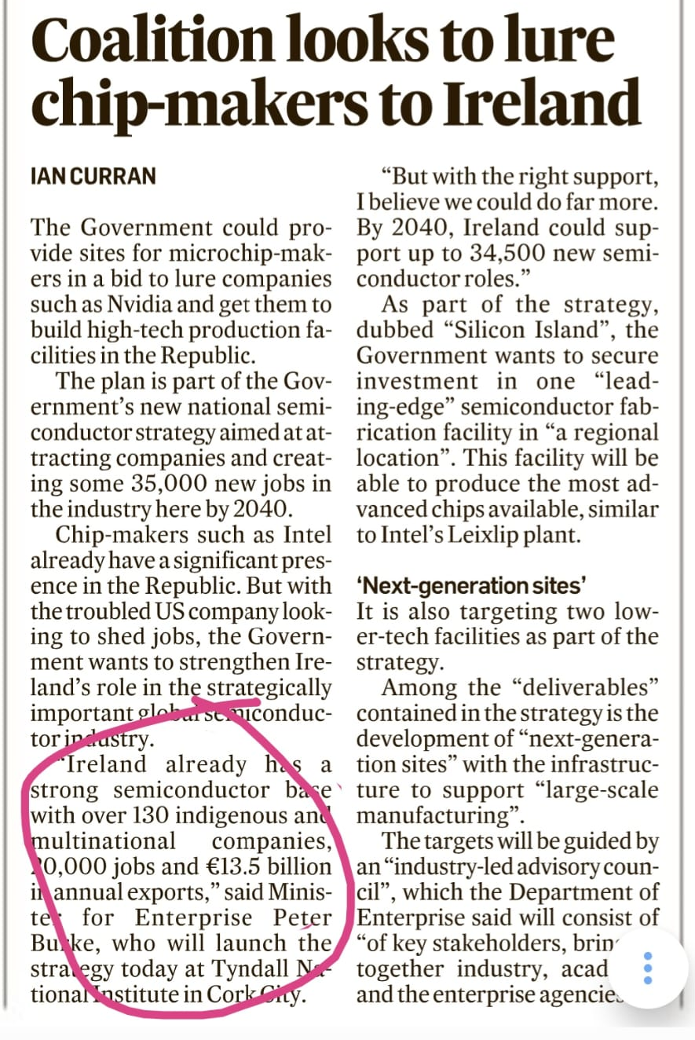

Slide 18
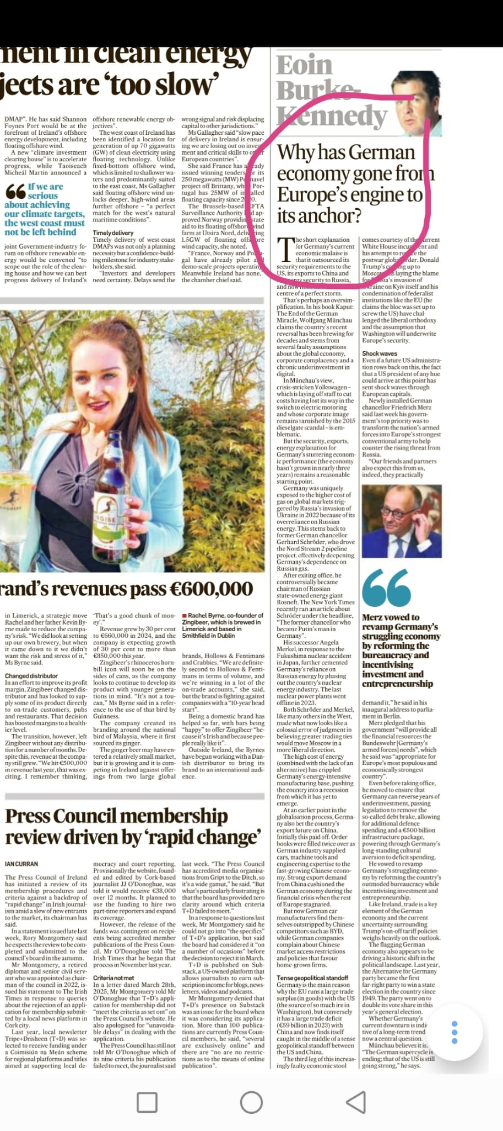

Slide 19
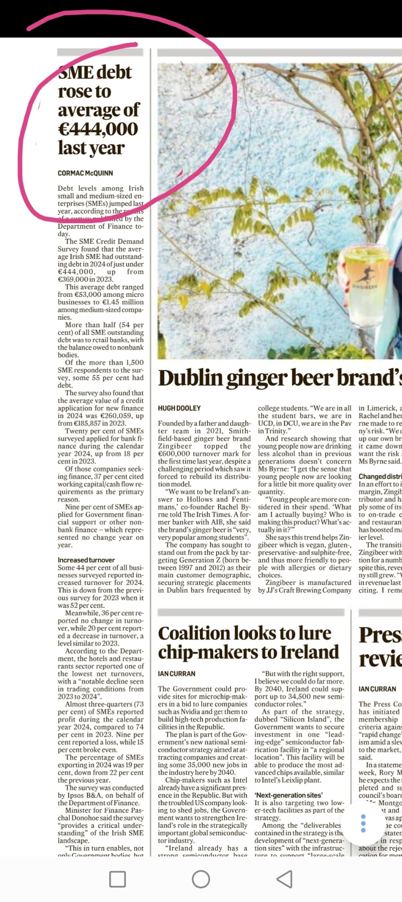

Slide 20
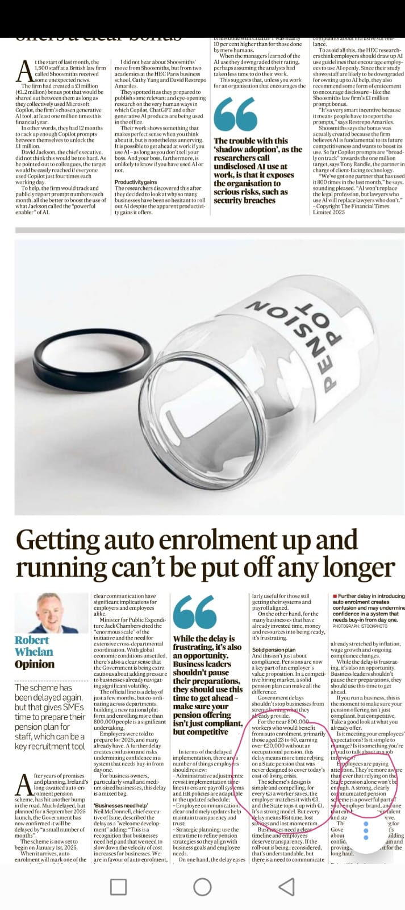

Slide 21
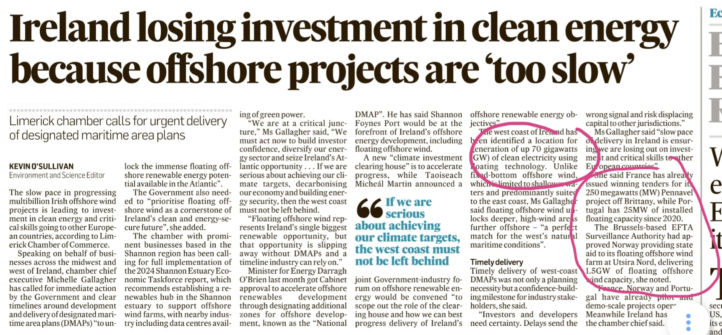

Slide 22
Thank you!

